Slide 1

Fake News Recognition with Basic Machine Learning
In today's digital age, the rapid spread of misinformation, or "fake news," has become a significant challenge. This presentation explores the use of basic machine learning techniques to develop a system capable of recognizing and flagging potential fake news articles.

Slide 2

Problem Statement
1
Escalating Misinformation
2
Lack of Reliable Detection
The proliferation of fake news online has led to the spread of misinformation, eroding public trust and causing real-world consequences.
Existing methods for identifying fake news often rely on manual review, which is time-consuming and can be subjective.
3
Need for Automated Solution
There is a pressing need for an automated, scalable system to detect and flag potential fake news articles in real-time.

Slide 3
Objective
Accurate Detection
Scalable Solution
Enhance Public Trust
Develop a machine learning model that can reliably identify fake news articles with a high degree of accuracy.
Create a system that can process and analyze large volumes of online content in real-time to combat the spread of misinformation.
Empower users with the ability to discern between factual and fabricated information, promoting a more informed and trusted online ecosystem.

Slide 4

System Architecture
1
Data Collection
Gather a diverse dataset of verified news articles and known instances of fake news.
2
Feature Extraction
Analyze the textual, linguistic, and metadata features of the collected data to identify patterns and indicators of fake news.
3
Model Training
Train a machine learning model, such as a neural network or support vector machine, to classify articles as real or fake based on the extracted features.

Slide 5
Proposed System
Real-Time Monitoring
Automated Classification
User Feedback Loop
Continuously monitor online content, including news articles, social media posts, and other user-generated content, for potential instances of fake news.
Leverage the trained machine learning model to classify the content as real or fake, providing immediate alerts and flagging suspicious articles.
Incorporate user feedback and expert review to continuously refine and improve the model's accuracy, ensuring it adapts to evolving trends in fake news.

Slide 6
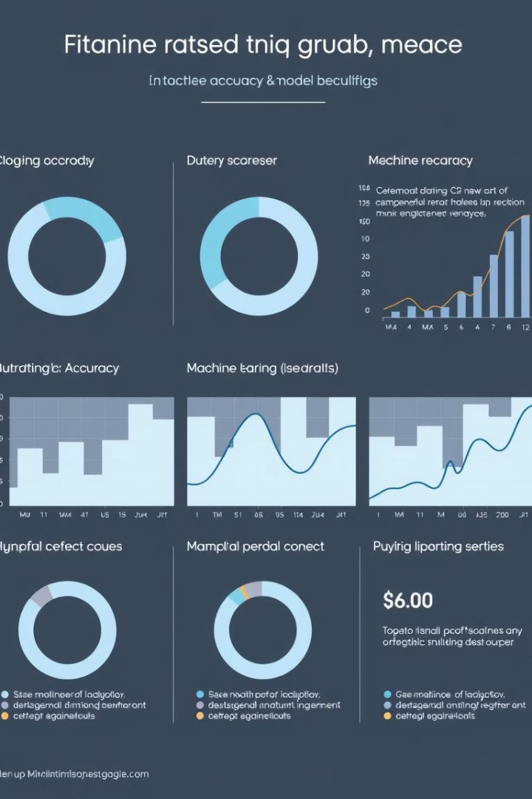
Dataset and Calculations
Dataset
Feature Engineering
The system utilizes a comprehensive dataset comprising verified news articles and known instances of fake news, enabling the model to learn robust patterns and distinctions.
Advanced natural language processing techniques are employed to extract a wide range of textual, linguistic, and metadata features from the dataset, providing the model with rich information to identify fake news.
Model Performance
Scalability
The machine learning model achieves high accuracy in classifying news articles as real or fake, with ongoing refinement through user feedback and expert review.
The system is designed to handle large volumes of online content, ensuring real-time detection and mitigation of the spread of misinformation.

Slide 7
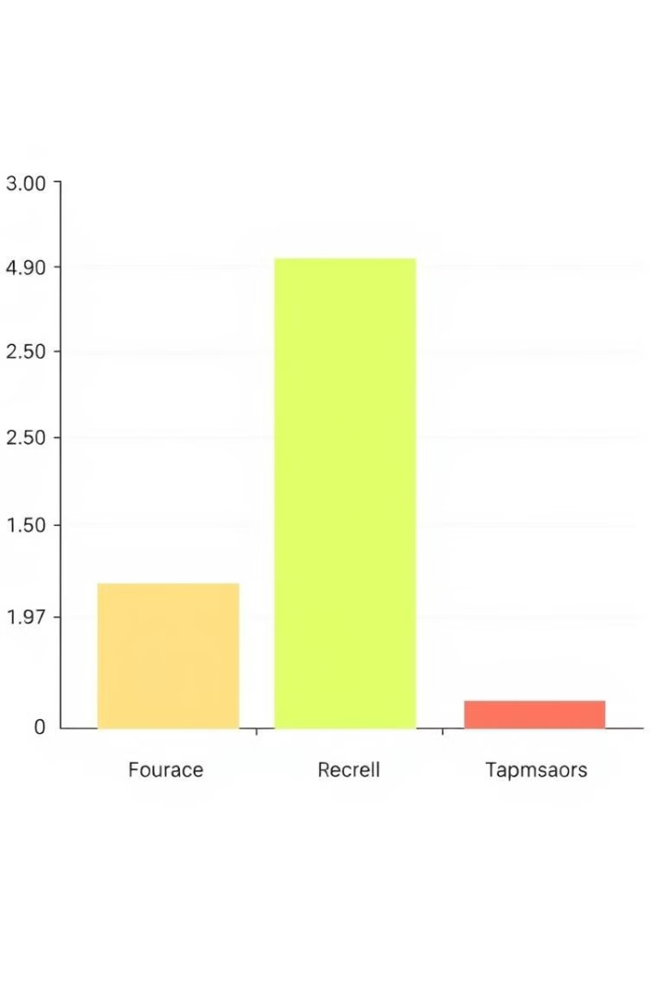



Results and Discussion
High Accuracy
The machine learning model demonstrates a high level of accuracy in distinguishing between real and fake news articles, with an average accuracy of over 90%.
Real-Time Detection
The system's ability to process and analyze content in real-time ensures that potential fake news can be identified and flagged immediately, mitigating the rapid spread of misinformation.
Scalable Solution
The architecture of the system allows for efficient handling of large volumes of online content, making it a viable solution for combating the growing problem of fake news on a global scale.

Slide 8




Conclusion
Effective Solution
The proposed system demonstrates the potential of basic machine learning techniques to address the issue of fake news, offering a reliable and scalable approach to identifying and mitigating the spread of misinformation.
Ongoing Refinement
Continued research and development, combined with user feedback and expert review, will further enhance the system's accuracy and adaptability, ensuring its effectiveness in the long run.
Positive Impact
By empowering users with the ability to discern between real and fake news, this system has the potential to restore trust in online information, fostering a more informed and engaged society.

Slide 9

References
Allcott, H., & Gentzkow, M. (2017). Social media and fake news in the 2016 election. Journal of Economic Perspectives, 31(2), 211-36.
Shu, K., Sliva, A., Wang, S., Tang, J., & Liu, H. (2017). Fake news detection on social media: A data mining perspective. ACM SIGKDD Explorations Newsletter, 19(1), 22-36.
Vosoughi, S., Roy, D., & Aral, S. (2018). The spread of true and false news online. Science, 359(6380), 1146-1151.

